Slide 1

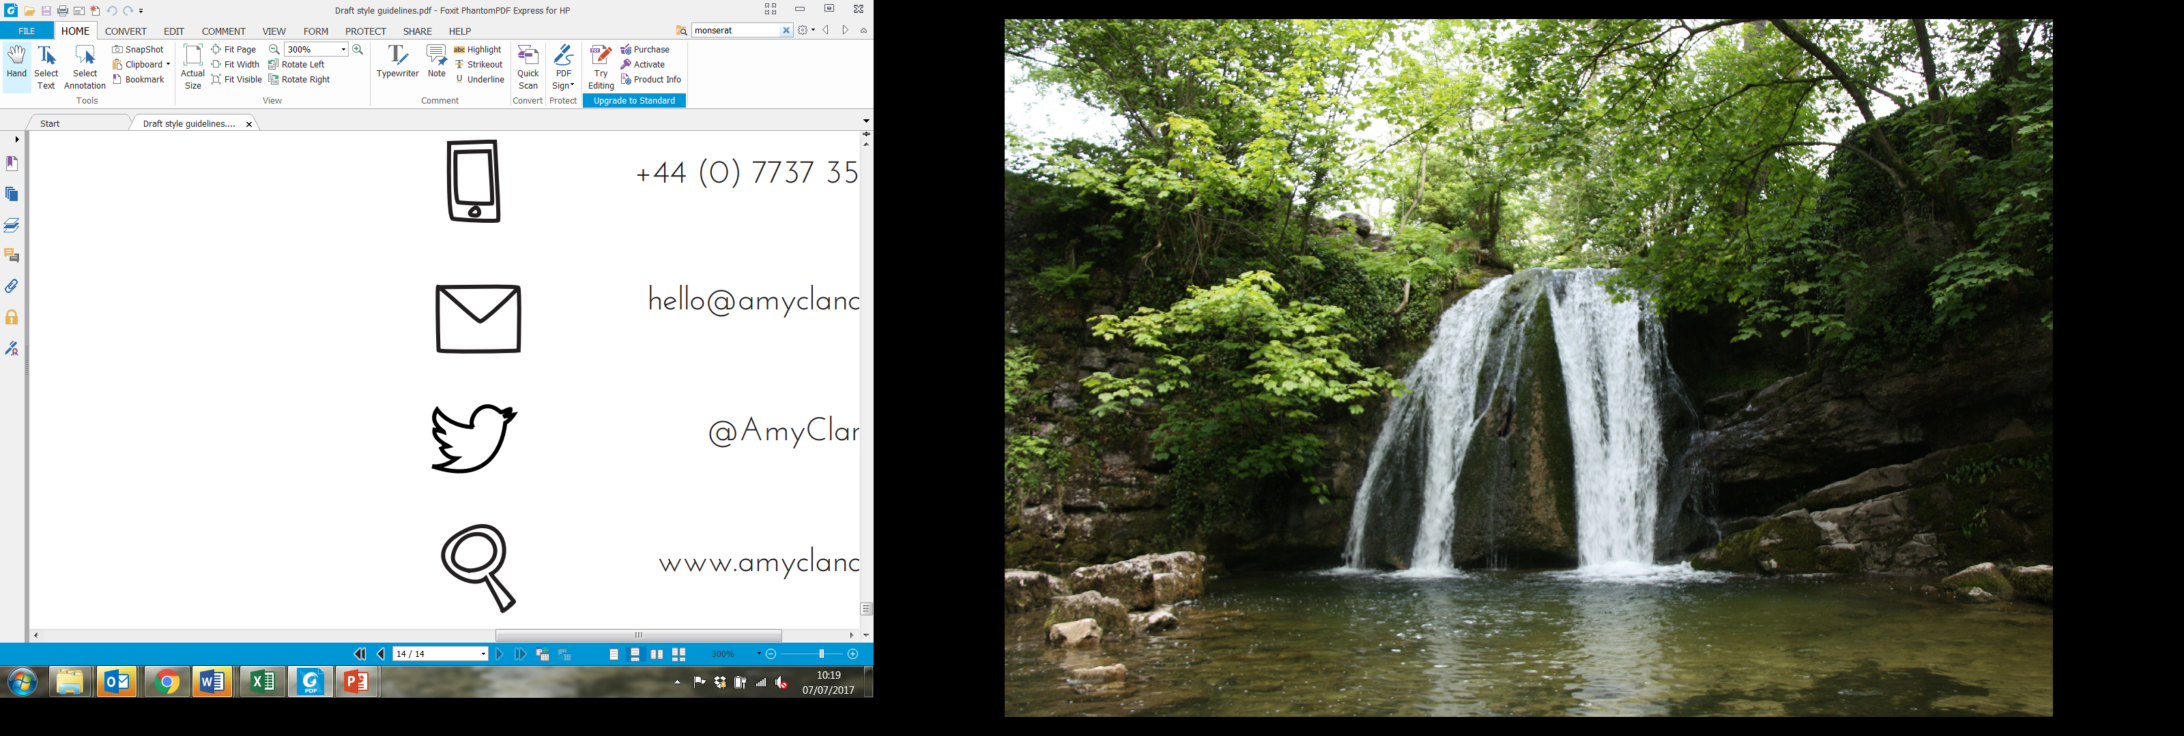
An introduction to community wealth building
John Heneghan
Associate Director
Lisa Adamson
External Affairs Officer
Lauren Bond
Anchor Network Coordinator
@CLESthinkdo

Slide 2
Plan for today
Introductions
Community wealth building – the theory and the practice:
  What problems does CWB seek to tackle?
  What is CWB? Principles, actors and intention
  The pillars
  Examples from around the UK and beyond
Advancing CWB in your place/sector
Wrap up

Slide 3
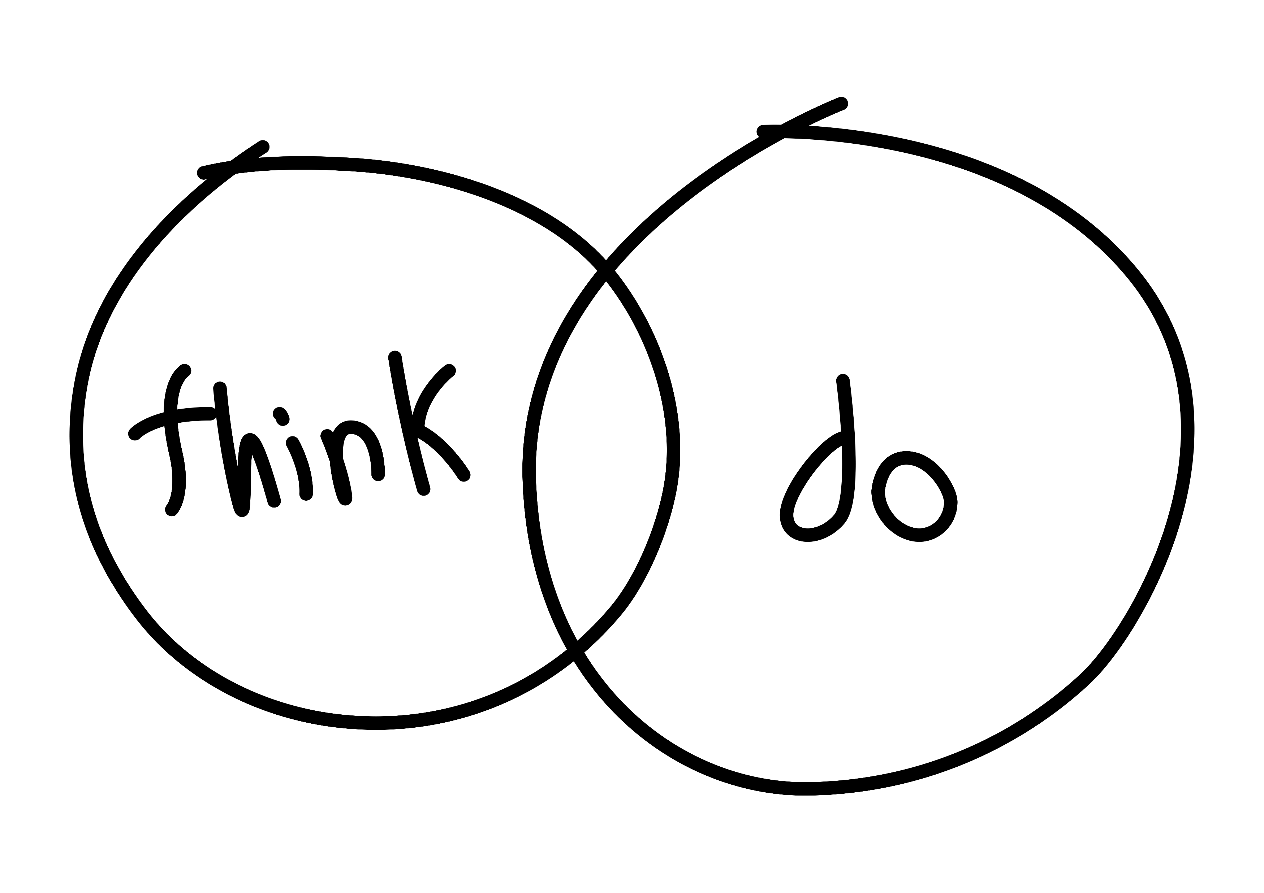
About CLES
The national organisation for local economies
Progressive economics for people, planet and place
Thinking and doing, to achieve social justice and effective public services

Slide 4
Introductions
Your name
Where you are on your community wealth building journey
Where you would like to get to by the end of the year
Notes:
Before we kick off, we’d like everyone to introduce themselves. We would like to understand where you’re coming at with this session, and what your community wealth building ambitions are. So, we’ll go round the room. Please can you give your name and organisation, where you are on your community wealth building journey, and where you would like to get to by the end of the year.

Slide 5
The case for community wealth building
What is it?
What problem does it seek to tackle?

Slide 6
What is community wealth building?
Community wealth building is a progressive approach to economics and economic development.
It seeks to change the way that our economies have come to function by aiming to retain more wealth and opportunity for the benefit of local people.
Notes:
What is community wealth building?
Community wealth building is a progressive approach to economics and economic development.
It seeks to change the way that our economies have come to function by aiming to retain more wealth and opportunity for the benefit of local people.
This is in contrast to our current economic model…

Slide 7
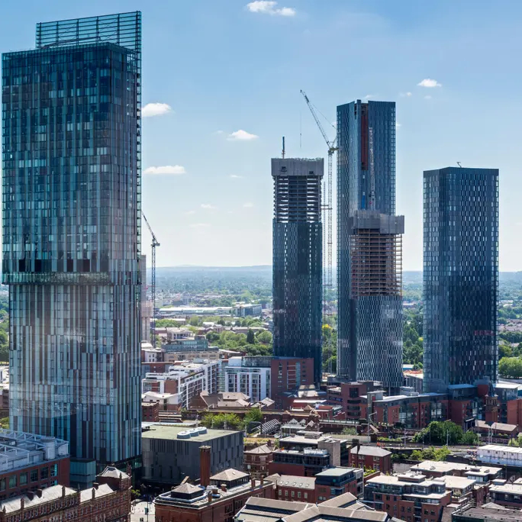

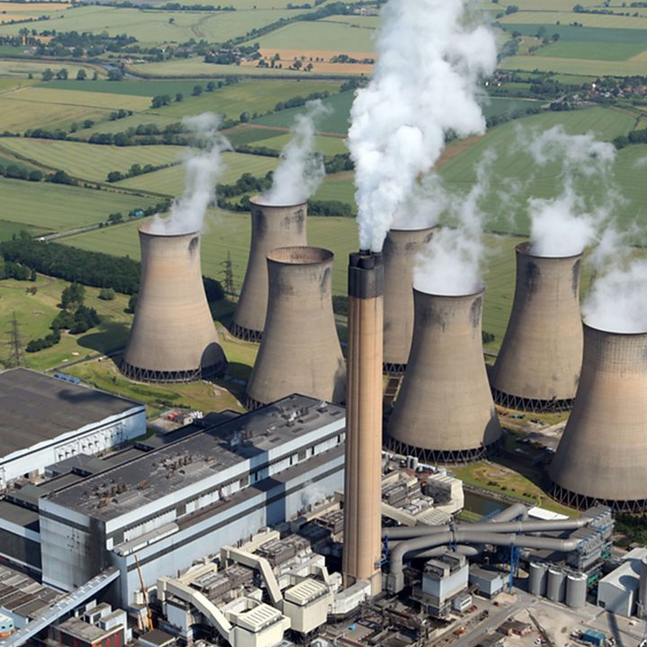
Our current economic model is failing
Notes:
In short, an economic model where a lot of economic activity and output is created by property ownership and an overly heated property market, a model where the local regeneration we see is overly reliant on speculative property development.
Just look at our towns and cities – we’re building stuff but these are commonly up market appartements which are unaffordable to many people- and its an economic model where a lot of business extract wealth for the benefit of distant shareholders (just think about companies like Amazon, Uber, Air B n B, Big superstores like B and Q, Supermarkets etc)
Now what’s wrong with this you might say…
Well in many ways our economy is failing:
We are too dependant on fossil fuels.
Money is too often extracted from the communities that create it.
Too many people are in precarious and insecure work.
Poverty is at record levels
Life expectancy is stalling
And the cost of living crisis rages on
SO let me do a bit of context setting and say something about the moment we now find ourselves in and why a community wealth building approach in so important

Slide 8

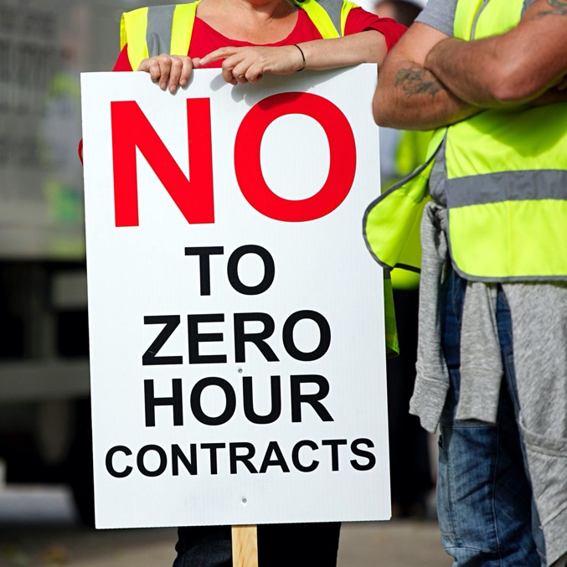
Our current economic model is failing
Notes:
For the last 2 years we have of course been in the grip of the COVID pandemic, a major public health and economic event of historical importance, unprecedented really in its magnitude in peacetime. In addition to the public health aspect of the pandemic, it also asked big questions about the nature of our economy. It’s exposed certain flaws, pre-existing cracks…
So let me explain..
Despite the fact that economic growth has risen dramatically since the 1980s in countries like the UK.
Recent UK stats tell us that
Poverty is at a record high - 14 million people are now living in poverty – more than one in five of the population, including four million children and two million pensioners.
Almost a million people now have no guaranteed work from one week to the next.
Life expectancy has stalled for the first time in a century. In some of the poorest areas life expectancy is moving in reverse.
The Trussell Trust alone gave out 2.1 million emergency food parcels to people in crisis in the last financial year (21/22). Almost 40% of these emergency food parcels went to children.
We also face the ongoing mortal threat of climate emergency – the full fury of which seems to have appeared almost everywhere this summer. We’ve seen waves of extreme weather that have smashed heat and rain records, killed hundreds of people and reminded us that unless we urgently change tack that our planet remains on a path to human-made destruction.

Slide 9
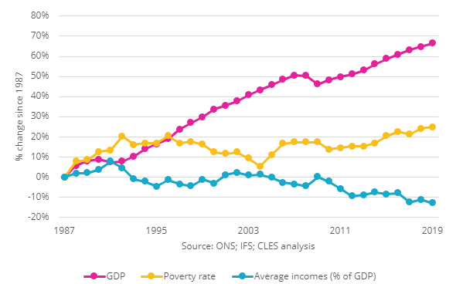
Our growth is exclusive
It’s not a given that even if your economy grows (as measured by GDP) that all people will benefit.
While GDP has increased, incomes have fallen and poverty rates have climbed.
This means that wealth is not benefitting the communities that create it.
Notes:
This graph shows us UK GDP growing to 2019 (the pink line) mapped against a declining average income (the blue line) and an increasing rate of poverty (the yellow line).
But, although most of us aren’t doing so well, some people are doing VERY well;
• In the UK, the five richest families own more wealth than 13.2 million people.
• Over the last ten years the number of billionaires in the UK has almost doubled and the wealth of the UK’s billionaires has more than doubled.
• The richest 1% of people in the UK own the same wealth as 80% of the population, or 53 million people.
So, in short – the economic growth we’ve seen is exclusive – it does not benefit everybody.

Slide 10
What can we do about it?
It’s time for a new approach to economics and economic development!
One which seeks to change the way our economies have come to function:
By aiming to retain more wealth and opportunity for the benefit of local people
Notes:
Is that it then? Is that the best we’ve got?
Right now we’re seeing a rush back to the old normal – this sense of let’s get back to our offices, get back to how things used to be.
But based on what we had before Covid, before the massive ramping up of the cost of living crisis – this amounts to little more than..
lets get the old patterns of wealth extraction, power and inequality back in play.
If the purpose of our economy is to be more than a wealth generating system for an elite few – then we know that the old model is failing to deliver – it failed to deliver positive outcomes for people, places and our planet.
So what can we do? We can look at different models, like community wealth building, which have the promise of something different.
I’ll hand over to Lauren now to take us on a deeper exploration of this concept.

Slide 11
“Community wealth building is a people-centred approach to local economic development, which redirects wealth back into the local economy, and places control and benefits into the hands of local people”

Slide 12

This is NOT the inclusive growth agenda
"Inclusive growth" focuses on what happens to growth after we have growth
Inclusive growth has no solutions for places with low or no growth
Notes:
From an inclusive growth perspective, inclusion is about what happens socially to growth after we have growth.
Whilst helpful, however, this aim is limited, and limiting, given the scale of the social issues and economic challenges facing our society.
What about areas that aren’t growing? What about sectors that aren’t high growth sectors?
By contrast, an Inclusive Economy offers a genuine progressive conceptual frame in which greater consideration is given to social benefits that flow from, and feed into, economic activity. With alignment to new forms of economic democracy, new municipalism and Local Wealth Building, we are seeing the rise of a genuine new progressive practice to local economic development.

Slide 13


The power of anchor institutions
Notes:
So, now that we have that cleared up, let’s look at community wealth building and the core principles and practices at the heart of it. One of the main assumptions of community wealth building is the power of anchor institutions. So at CLES, a lot of our work is with anchor institutions.
Anchor institutions are large established organisations, rooted in local communities, which can improve local economic and social wellbeing through the use of their spend, employment practices, and use of land and assets.
In terms of impact, anchor activity affects the social determinants of health: income, wealth, economic equality, job stability, sense of agency, assess to affordable safe housing.
Idea of anchors is focused on cultivating place-based assets and generating wealth that is retained within the local area, as opposed to being extracted as share-holder profit
Anchor networks.

Slide 14





The pillars of community wealth building
Making financial power work for local places
Socially productive use of land & property
Fair employment & just labour markets
Plural ownership of the economy
Progressive procurement
Notes:
So, anchor institutions are key to our understanding of community wealth building and the way that CWB functions in a place. There are five other key principles to community wealth building that need to be understood if you want to understand the whole of CWB, and these are what we call ‘The 5 Pillars of CWB.’
At the heart of community wealth building is the principle that wealth is broadly held. Cooperatives, mutually owned businesses, SMEs, municipally owned companies enable the wealth generated in a community to stay in that locality and play a vital role in counteracting the extraction of wealth. Anchors therefore have a key role to play in encouraging a diverse range of ownership models in their supply chains.
Ensuring that financial investments and pension funds are directed towards local investment priorities, bringing transformative capital to locally rooted enterprises.
Often the biggest employers in a place, the approach anchors take to employment can have a defining effect on the employment prospects and incomes of local people. Recruitment from lower income areas, commitment to paying the living wage and building progression routes for workers are all examples of the actions Anchors can take to stimulate the local economy and bring social improvements to local communities.
Its about socialising spend. By adopting robust social value frameworks, tailored to local priorities, anchors can make the best use of public pound, generating wider social and economic value from the procurement and commissioning process.
By supporting equitable land development (through establishment of community land trusts) and development of underutilised assets for community use.

Slide 15
Socially productive use of land & property
Context
Ownership of land is concentrated in the hands of the few
The least wealthy 30% have no net property wealth at all
Solution
Assets are owned and managed in ways which ensure that they generate wealth for local citizens
Community Land Trusts and Public-Common Partnerships
Notes:
How land and property assets are owned and managed are key features of any local economy. Land ownership matters because it is an expression of economic and political power, and in the UK the ownership of land is concentrated in the hands of the very few while the least wealthy 30% have no net property wealth at all.
The solution of a CWB approach would be that assets were owned and managed in ways which ensure that they generate wealth for local citizens, for example public land owners can transfer under-utilised assets to Community Land Trusts, or through Public-Commons Partnerships.
Community Land Trusts (CLTs) are democratically run organisations set up to develop and manage land and assets in the interests of their members. They tend to be set up to solve a local problem, such as unaffordable housing, or derelict and unproductive land. CLTs are driven by concerned members of communities who wish to take economic development into their own hands. Whilst they tend to be vehicles for the long-term stewarding of affordable housing, they can also develop other assets important to the community, such as community-run pubs, food growing or workspaces. Currently, there are 263 legally incorporated CLTs in England and Wales. Oxford is the least affordable city in the UK. To combat this, Oxford CLT are currently developing six affordable, co-operative and environmentally sustainable homes for rent. Oxford CLT have also set their sights on two more locations in the city: the Irving Building, where they hope to redevelop a former school into 26 zero carbon affordable homes; and Wolvercote Paper Mill, an ambitious bid to buy land from The University of Oxford for a 260-home eco-village.

Slide 16
Progressive procurement
Context
Cost is often the dominant determining factor in who gets contracts.
Many anchor institutions spend large percentages outside their local area, and with businesses which are not socially generative.
Solution
Anchor institutions can use their procurement processes to create dense local supply chains and support businesses which are more likely to employ locally and recirculate wealth.
Notes:
By adapting their procurement processes and decision making, anchor institutions can create dense local supply chains and ecosystems of local enterprises, SMEs, employee owned businesses, social enterprises, cooperatives and other forms of community ownership.
This is important because these types of businesses are more likely to support local employment and have a greater tendency to recirculate wealth and surplus locally, helping to reduce carbon footprint.
Preston’s efforts to localise the impact of collective spending amongst the city’s anchor institutions has brought millions of pounds back into the local economy. The recirculation of over £200m being spent with local suppliers as a result of the changes in procurement behaviour across anchor institutions has had a positive multiplier effect on local jobs, health and wellbeing. This is partially reflected by the fact that in 2018 Preston was named the ‘Most Improved City in the UK’.

Slide 17
Making financial power work for local places
Context
The UK banking sector is orientated to global markets rather than local investment
Access to credit is the life blood of many small businesses but there has been a stagnation of lending
Solution
Measures that channel investment to local communities while still delivering a steady financial return for investors, including:
Local pension funds, credit unions, mutuals and community banks
Notes:
Rather than attempting to attract national or international capital, community wealth building seeks to increase flows of investment within local economies, by harnessing the wealth that exists locally. Measures that channel investment to local communities while still delivering a steady financial return for investors, including: Local pension funds, credit unions, mutuals and community banks. So to give you an example of some of these:
Local authority pension funds held £275bn in assets across England and Wales in 2018 and make substantial investments across the UK. Community wealth building seeks to channel this wealth to local communities while still delivering a steady financial return for portfolio holders. It is important to consider not just the geography of where the investments are going, but the nature of the business invested in. Channelling investment to the more socially generative side of the economy has multiplier effects upon social, economic and environmental value. ­
Credit unions offer an alternative to traditional banks and building societies for personal saving and borrowing.
They can be a lifeline for individuals unable to access ordinary banking products. As non-profit entities, there are no third-party shareholders extracting profit, money is simply reinvested for the mutual benefit of the members. Traditionally, members would be from the same town, industry or trade union, although their reach has now expanded online. In 2018, credit unions across the UK had over 2 million members and held £3.3bn in total assets. London Plus Credit Union works in partnership with Hexagon Housing Association to give tenants access to financial services such as low-cost loans to tackle predatory payday lending, safe savings to avoid unexpected debts and money management advice. The credit union serves residents and workers from a selection of London boroughs, housing association tenants, as well as members of specific churches and Unite the Union.
LEAVE
A group of innovators, led by RSA Fellow James Moore, and a team with over 150 years banking experience between them have set up the Community Savings Bank Association (CSBA) to facilitate the development of a network of independent, customer owned, local banks across the UK.
Work led by the Royal Society of Arts, Manufactures and Commerce (RSA) is promoting this regionally focused, mission-led model of community banks to advance the banking sector and put sustainable development, people and planet, back at the heart of the UK investment sector.
The first of the Community Savings Bank Association will be Avon Mutual, which will take local savings and use them to create local loans. Avon Mutual aims to serve the everyday financial needs of ordinary citizens, local community groups, and small and medium sized companies. It will also work closely with community development corporations, community development finance institutions, local social investment funds, revolving loan funds and others. It aims to become a key anchor institution focused on shifting the region’s economy to promote sustainable and equitable prosperity.

Slide 18
Fair employment and just labour markets
Context
The rise of in-work poverty and zero hour contracts
Wages in the UK falling whilst inflation increases during a cost-of-living crisis
Solution
Anchor institutions have a defining effect on the prospects of local people. Recruitment from lower income areas, paying the Living Wage and building progression routes all improve local economies.
Notes:
The rise of in-work poverty and zero hour contracts coupled with the erosion of job security mean that the reality of employment for many in the UK is increasingly precarious, especially as inflation continues to rise whilst wages fall. Anchors can play a role in supporting local people access employment and develop their skills through the establishment of employment and training initiatives. Such initiatives can transform the life chances of local residents in some of the most disadvantaged areas of the UK by providing opportunities and support for jobseekers, providing pre-recruitment training and job matching to local employers.
Leeds Teaching Hospitals NHS Trust
The Trust’s pre-employment training scheme offers a mixture of work experience and knowledge building around basic Maths and English. The programme runs for a total of six weeks. The first two weeks are spent training at Leeds City College, then the following four weeks are spent on a work placement within the Trust, with ongoing support and training (four days in work, one day in Leeds City College). The programme has a particular focus on building the confidence of the long-term unemployed.
The Trust also has a focus on promoting careers to young people in the local area, and has established a number of health career ambassadors and have a cohort of staff who go into schools in areas of high deprivation.

Slide 19
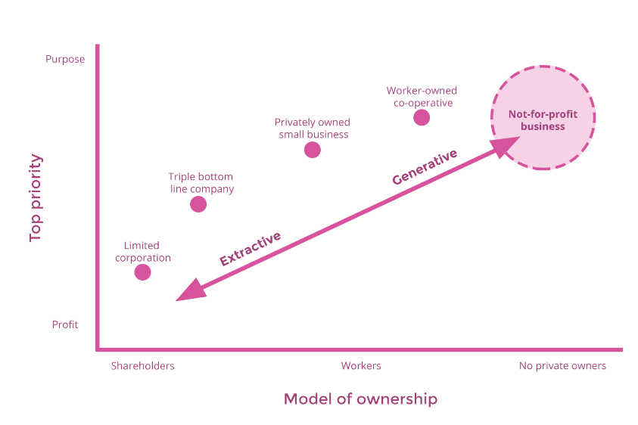
Plural and democratic ownership of economy
Notes:
The UK is the fifth most unequal country in the world, according to the OECD. Financial wealth is held by a small minority, 44% of the UK’s wealth owned by just 10% of the population. At a local level, this means that the wealth generated by workers, local people, communities, local enterprise and business in our towns and cities does not flow back to them, but instead is extracted by distant shareholders as profits and dividends.
At the heart of community wealth building is the principle that wealth is broadly held. Cooperatives, mutually owned businesses, SMEs, municipally owned companies and socially minded companies enable the wealth generated in a community to stay in that locality and play a vital role in counteracting the extraction of wealth as they are more likely to employ, buy and invest locally. Anchors therefore have a key role to play in encouraging a diverse range of ownership models in their supply chains.

Slide 20
Questions?

Slide 21
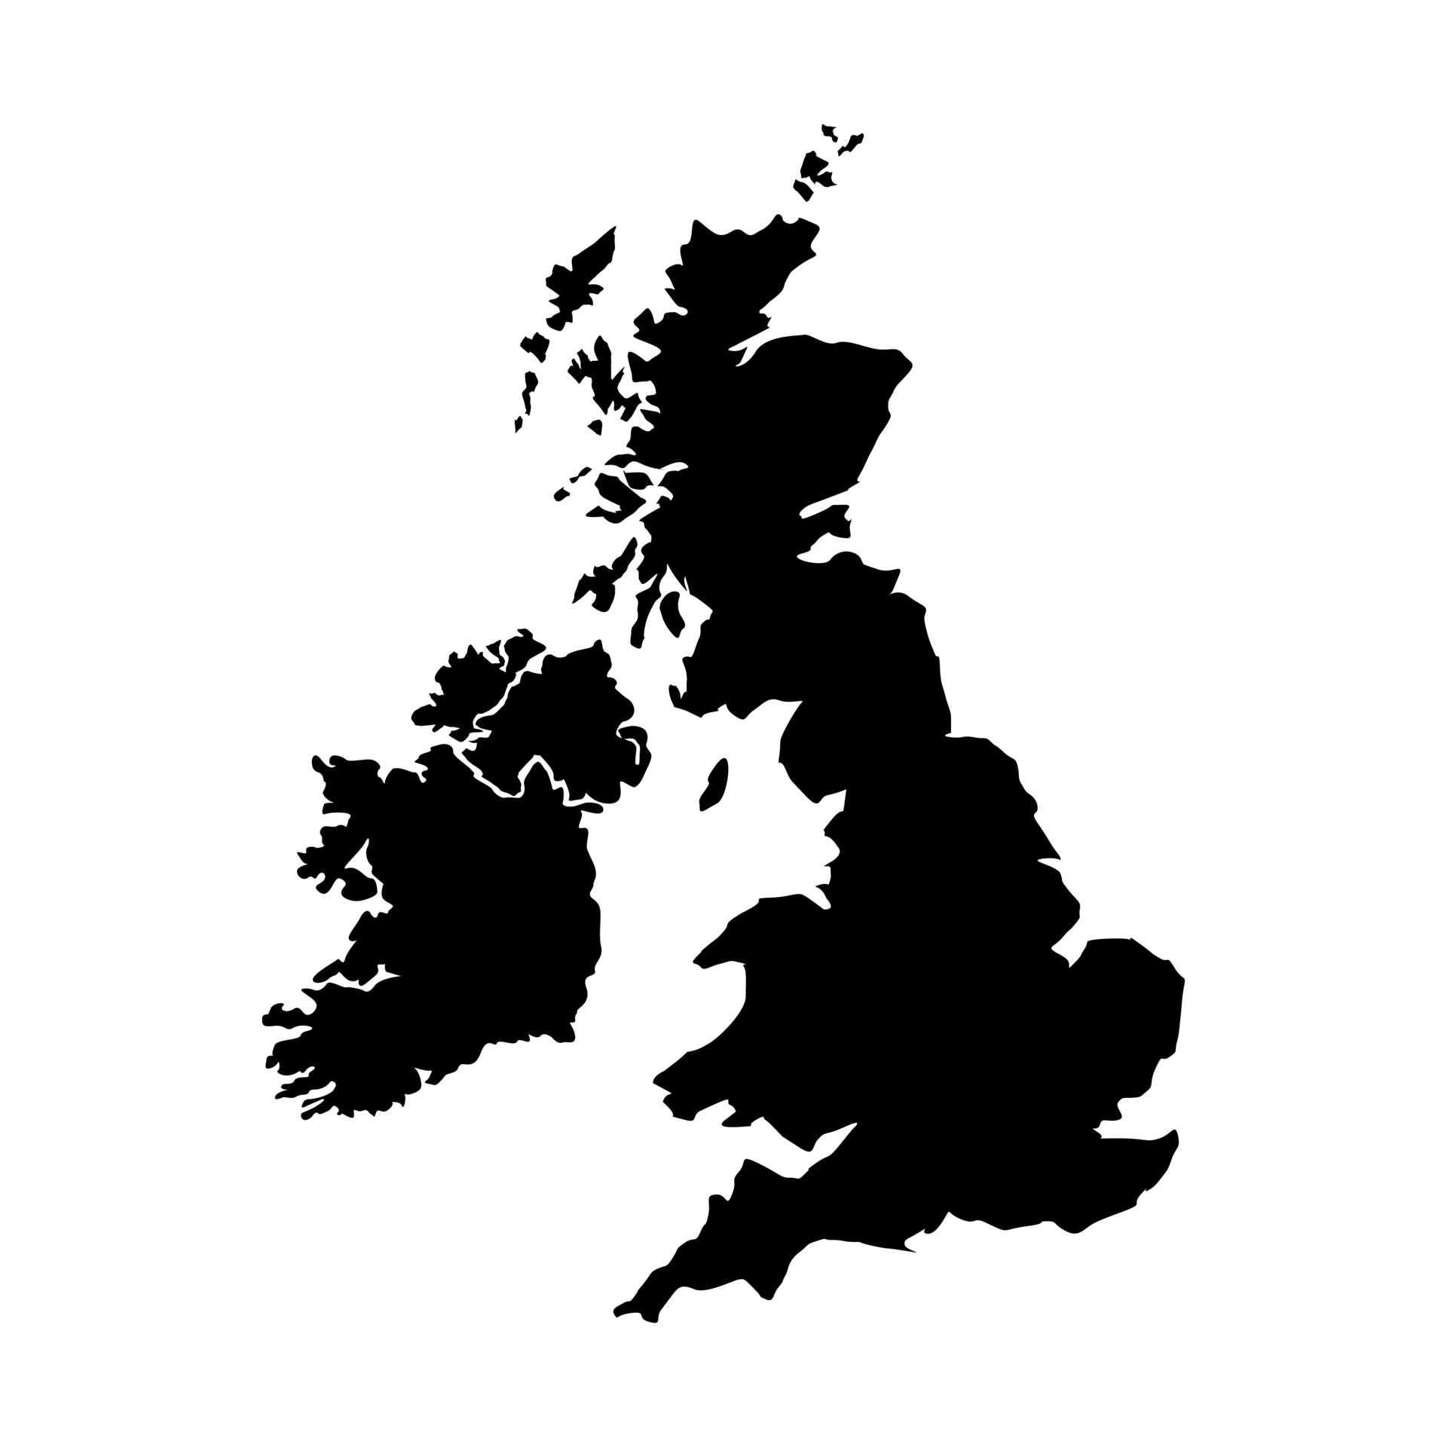
Community wealth building in practice
CHALLENGE
High levels of unemployment, low skills and anchors with high vacancies
CWB SOLUTION - iCan
An employment solution set up through covid to help recently redundant hospitality workers move into an NHS job
Now expanded to match unemployed Birmingham residents with entry-level roles
A piece of community wealth building infrastructure
Fair employment & just labour markets
Notes:
University of Birmingham are redeveloping a massive brownfield site in central Birmingham as the ‘Birmingham Health Innovation Campus’ as a ‘world leading economic hub for life sciences’.
Construction has already started, the first building is due to open October next year and then there will be phased build over the next ten years.
When it is complete there will be 10,000 jobs, 4,000 of which will be in standard corporate services – i.e accessible for many Birmingham residents.
The University is really keen for this health technology campus to also address health inequalities, both directly and indirectly, and this includes both local recruitment and local spend. In fact they want to set up an ‘official collaboration’ with a memorandum of understanding with the Birmingham Anchor Network to help source these jobs and businesses.
The types of opportunities we discussed are:
• Employment
o Immediate help with him recruiting to his project team. For example – he is currently looking for an assistant office manager.
o Support to the two main developers (Bruntwood and Cisk(?)) to recruit into construction jobs over the next ten years.
o Recruitment into permanent roles as the various facilities are opened.

Slide 22

Community wealth building in practice
CHALLENGE
Climate crisis and rising energy costs
CWB SOLUTION – Oldham Energy Futures
A programme with two low-income communities in Oldham which puts residents at the heart of decision making and aims to transform the ownership of energy in the borough
Involves three pilot projects:
  Upgrade local buildings and create low carbon homes
  Develop an EV and e-bikes local mobility project
  Install new renewable energy generation for the borough
Plural ownership of the economy

Slide 23
Community wealth building in practice
CHALLENGE
Low levels of local spend, confusing procurement rules and poor relationships with local businesses
CWB SOLUTION – Quick Quotes Process
North Ayrshire Council implemented a ‘quick quotes process’ whereby contracts between £10-50k are ringfenced for local suppliers
Built a relationship between the procurement and business growth teams
Support local businesses in navigating the process
Progressive procurement

Slide 24
Community wealth building in practice
CHALLENGE
Disconnected adult social care providers and low pay for staff
CWB SOLUTION – Wigan Ethical Homecare Framework
Wigan’s homecare system involved 25 providers at varied cost and quality, disconnected from local communities with a poorly rewarded workforce
Wigan Council changed this by creating the Ethical Homecare Framework: to be part of the framework employers had to meet certain demands, such as using values-based approaches to recruitment and all paying the same hourly rate
It drove up employment standards, increased pay, and reduced staff turnover greatly
Fair employment & just labour markets

Slide 25

Community wealth building in practice
CHALLENGE
Thousands of homes that need decarbonising, and residents in need of skilled jobs for the future
CWB SOLUTION – Lewes Retrofit Market Shaping
Lewes has partnered with seven other local authorities across East Sussex and the greater Brighton area
They own a combined 3,500 council homes – the grand prize is to retrofit each of those homes to meet carbon targets, but by using local firms to conduct the work
Lewes is using this project to shape the market, by creating the demand for retrofit which will ultimately fuel the supply of more retrofit firms in the area, which will create skilled, good quality jobs for local people
Fair employment & just labour markets
Socially productive use of land and assets

Slide 26
Community wealth building in practice
CHALLENGE
NHS organisations with large budgets, health inequalities growing
CWB SOLUTION – Health institutions as key anchors
Health spending has the potential to be a core economic driver in local economies
Hywel Dda University Health Board (HDUHB) are exploring how a progressive health board can maximise the impact of its spending power for wellbeing in Wales
HDUHB is developing a whole local health board approach to spending, collaborating with other anchors on areas such as food procurement
Progressive procurement

Slide 27
Questions?

Slide 28
Break
5 mins

Slide 29
Discussion
Which of these examples resonated with you?
How would these examples translate to your place/organisation?
20 mins

Slide 30
Examples in practice:
Plural ownership of the economy
  Insourcing (Liverpool, Newham, Islington, Stoke-on-Trent…)
  Municipal ownership (Preston leisure complex)
  Cooperative development (Worker-owned care cooperatives, NY; Islington Coop development agency)
  Conversion local small business to workers coops (North Ayrshire)
  Community energy (Plymouth Energy Community)
Notes:
North Ayrshire: Family businesses, 30% second, 12% third generation. Disappearance of these is a real threat given they are a definining feature. So employed a family business advisor and discusses succession plans, and raises idea of EO Trust. Very successful at raising number of conversions.
30

Slide 31
Examples in practice: Socially productive use of land and property
  Municipally owned housing developers (Barking and Dagenham)
  Using publicly owned land to build affordable housing & support local community (Sandwell and West Birmingham NHS Trust)
  Community-led housing (CHaCO, Leeds)
  Hardwiring social justice into planning frameworks (Islington Council)
  Using land for renewable energy (Plymouth Energy Community)

Slide 32
Examples in practice: Making financial power work for place
  Community banks (South West, Lancashire, London, Wales)
  Using pension funds for local investment (Preston and London Pension Fund)
  Capitalising Credit Unions (Many UK Councils)
  Community and municipal investment (community share offers, Community municipal investment)
Notes:
32

Slide 33
Examples in practice: Fair employment, just labour markets
  Development of local labour markets to grow workforce from deprived areas, underserved sections of population (Leeds Hospital Trust)
  Living wage places (Dundee & Sunderland)
  Progression in work (Council and hospital trusts)
  Pre-employment support (Northern Care Alliance)
  Fair Work (Scottish Government)
Notes:
Progression –
33

Slide 34
Examples in practice: Progressive procurement
  Supply chain development in deprived areas (Manchester City Council)
  Social Value community wish-lists (Perth and Kinross)
  Market shaping to disrupt dominance of extractive suppliers (Adult Social Care commissioning, Wigan)

Slide 35
What does this mean for you?
Notes:
DIGESTING - Second facilitator bits
5 mins thinking individually
ACTION
What are the opportunities for this in your place.
Who will you speak to about it.
What will you do next.
MIRO/MURAL: Box for post-its for each element.

Slide 36
What next?
What will you do on Monday?
10 mins

Slide 37
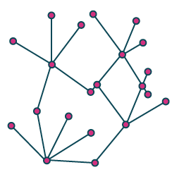
Get in touch
0161 236 7036
laurenbond@cles.org.uk
lisaadamson@cles.org.uk
johnheneghan@cles.org.uk
@CLESthinkdo
www.cles.org.uk

