Slide 1
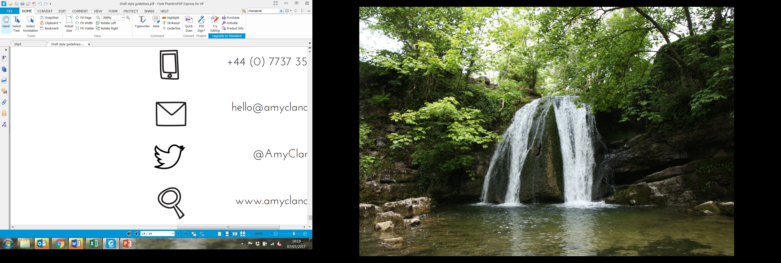
An introduction to community wealth building
Lauren Bond
Senior Researcher
Victoria Bettany
Senior Researcher
@CLESthinkdo

Slide 2
Plan for today
Introductions
Community wealth building – the theory and the practice:
  What problems does CWB seek to tackle?
  What is CWB? Principles, actors and intention
  The pillars
  Examples from around the UK and beyond
Advancing CWB in your place/sector
Wrap up

Slide 3
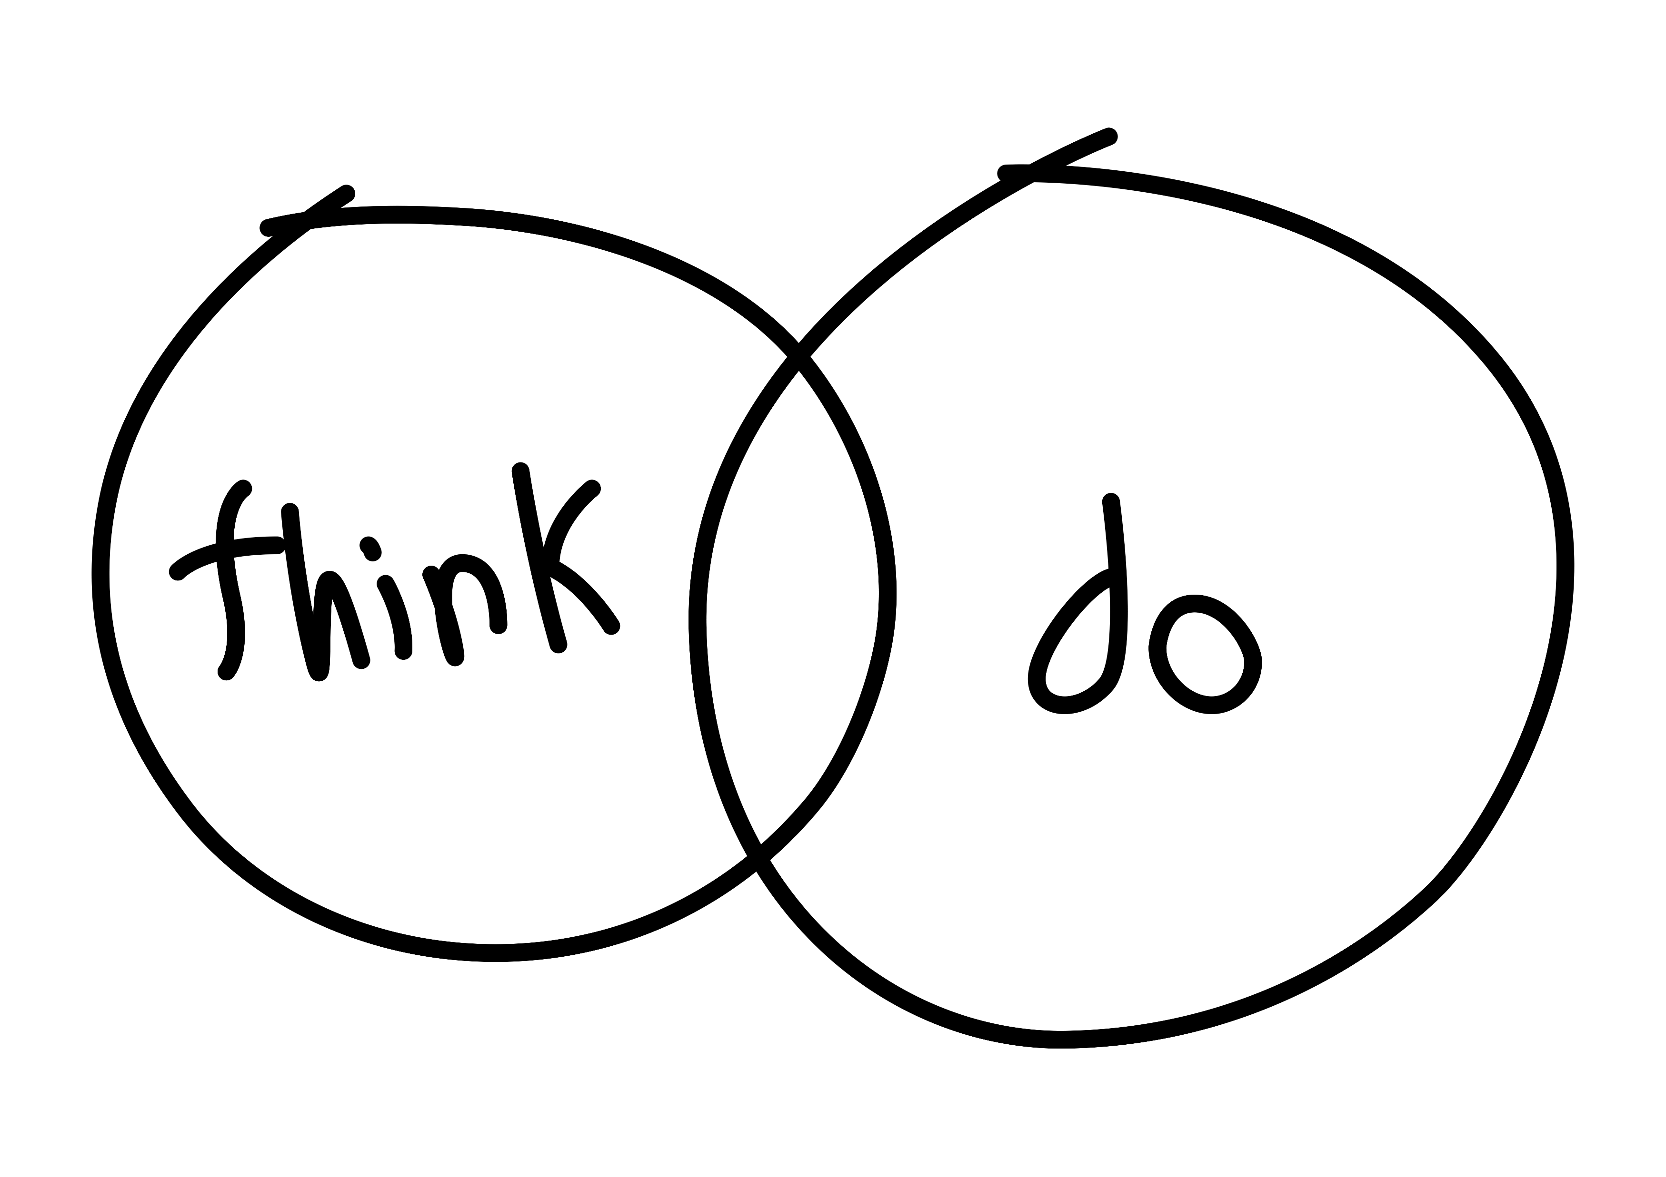
About CLES
The national organisation for local economies
Progressive economics for people, planet and place
Thinking and doing, to achieve social justice and effective public services
Notes:
The national organisation for local economies​
​
Since our inception in 1986 our mission has been about the development of local economies which work for people, planet & place.​
Do research, develop ideas and convene conversations about local economic change and public services.​
Independent, charitable company.​
Lead organisation for community wealth building in the UK​
Increasing the flow of wealth into local communities​ and
Harnessing the combined heft of anchor institutions ​

Slide 4
Introductions
Your name
Where you are on your community wealth building journey
Where you would like to get to by the end of the year
Notes:
Before we kick off, we’d like everyone to introduce themselves. We would like to understand where you’re coming at with this session, and what your community wealth building ambitions are. So, we’ll go round the room. Please can you give your name and organisation, where you are on your community wealth building journey, and where you would like to get to by the end of the year.

Slide 5
The case for community wealth building
What is it?
What problem does it seek to tackle?

Slide 6
What is community wealth building?
Community wealth building is a progressive approach to economics and economic development.
A set of guiding principles to help us build a more inclusive economy.
It seeks to change the way that our economies have come to function by aiming to retain more wealth and opportunity for the benefit of local people.
Notes:
What is community wealth building?
Community wealth building is a progressive approach to economics and economic development.
It’s a set of guiding principles to help us build a more inclusive economy.
An economy where more wealth and opportunity are retained for the benefit of local people.
This is in contrast to our current economic model…

Slide 7
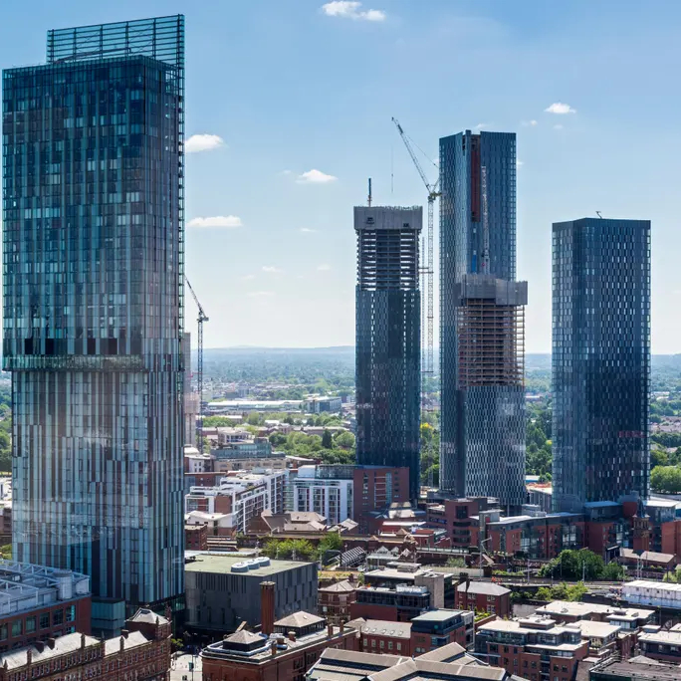


Our current economic model is built on wealth generation and extraction
Notes:
In short, an economic model where a lot of economic activity and output is created by property ownership and an overly heated property market, a model where the local regeneration we see is overly reliant on speculative property development.
Just look at our towns and cities – we’re building stuff but what we’re building tends to be up-market apartments which are unaffordable to many people
Its an economic model where a lot of businesses extract wealth for the benefit of distant shareholders (just think about companies like Amazon, Uber, Air B n B, Big superstores like B and Q, Supermarkets etc)
Now what’s wrong with this you might say… those types of companies employ lots of people!

Slide 8


Our current economic model is failing
Notes:
And that’s true, in fact, economic growth has roughly doubled in the UK over the last 30 years, but crucially, this growth has failed to produce social, economic and climate benefits for all but a select few.
Life expectancy has recently stalled for the first time in a century, and record numbers of people in the UK now live in poverty.
Larger families and single-parent families are particularly affected. As are Bangladeshi, Pakistani and Black families, who continue to have higher poverty rates and worse outcomes across many areas.
The most recent data also shows a big rise in destitution (for clarity here Destitution is defined as “going without the essentials we all need to eat, stay warm and dry, and keep clean”. Stats from the Joseph Rowntree Foundation show us that more than a million households in the UK (containing 2.4 million people, including 550,000 children) are living in destitution – extreme hardship – this number is being further exacerbated by the current cost of living crisis.
As if that wasn’t evidence enough that our current economic model is failing, the climate emergency is escalating rapidly. The latest reports from the UN’s International Panel on Climate Change indicate that temperature changes are happening faster, with the likelihood that the world will reach a climate tipping point sooner than originally forecast.

Slide 9
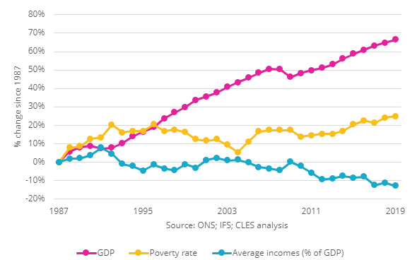
Our growth is exclusive
It’s not a given that even if your economy grows (as measured by GDP) that all people will benefit.
While GDP has increased, incomes have fallen and poverty rates have climbed.
This means that wealth is not benefitting the communities that create it.
Notes:
This graph shows us UK GDP growing to 2019 (the pink line) mapped against a declining average income (the blue line) and an increasing rate of poverty (the yellow line).
So, in short – the economic growth we’ve seen is exclusive – it does not benefit everybody.
Here’s some stats to illustrate;
• In the UK, the five richest families own more wealth than 13.2 million people.
• Over the last ten years the number of billionaires in the UK has almost doubled and the wealth of the UK’s billionaires has more than doubled.
• The richest 1% of people in the UK own the same wealth as 80% of the population, or 53 million people.
Again, the economic growth we’ve seen is exclusive – it does not benefit everybody.

Slide 10
What can we do about it?
It’s time for a new approach to economics and economic development!
One which seeks to change the way our economies have come to function:
By aiming to retain more wealth and opportunity for the benefit of local people
Notes:
In seeking to challenge this exclusivity then, a CWB approach is about purposeful intervention in the economy.
Its about asking ourselves…
What kind of economic activity can we promote to make things more inclusive?
I’ll hand over to Lauren now to take us on a deeper exploration of this concept and to provide us some light at the end of the tunnel!

Slide 11
“Community wealth building is a people-centred approach to local economic development, which redirects wealth back into the local economy, and places control and benefits into the hands of local people”

Slide 12

The power of anchor institutions
Local government
The NHS
Universities and colleges
Housing associations
Large private businesses…?
Notes:
CWB aims to change the nature of our local economies by harnessing the economic and social power of locally rooted institutions.
These are commonly referred to as anchor institutions. Typically, this means local councils, hospitals, universities, colleges and housing associations, and potentially, large private sector companies too.
Have an important presence in a place, usually through a combination of: being largescale employers, the largest purchasers of goods and services in the locality, controlling large areas of land and/or having relatively ﬁxed assets.​
Are tied to a particular place by their mission, histories, physical assets and local relationships.
These are organisations that can come together over time to create anchor networks where organisations commit to using their economic influence work in partnership to build place-based local and inclusive economic development practices
SO how do they use their impact to do this?

Slide 13



Vision and purpose
Notes:
First and foremost, it’s about establishing the right kind of economic strategy and here of course there is a particular role for local government
Minimising the extraction of wealth and building prosperity for all should be the aim of all local economic strategies.
At CLES we talk about importance of an inclusive economy.
An economy which is focussed on social goals, social justice, environmental sustainability and prosperity for all.
An economy that:
decouples the idea that economic success in contingent on growth.
And recognises that continual growth is impossible on a finite planet with finite resources.
Crucially, this will require abandoning GDP as the leading indicator of economic health and to adopt instead a broader set of metrics - livelihood, wellbeing and happiness as the key tenets of economic success – not growth!!
While economic strategy and planning has traditionally fallen under the jurisdiction of local governments, other anchor institutions, communities and the VCSE sector should play a key role in establishing these priorities.
**potential discussion – how do you (social orgs) engage w/your ccl, what’s the quality of the relationship**

Slide 14





The pillars of community wealth building
Making financial power work for local places
Socially productive use of land & property
Fair employment & just labour markets
Plural ownership of the economy
Progressive procurement
Notes:
In addition to having the right strategic purpose, we talk about CWB action across 5 key pillars or levers of activity

Slide 15
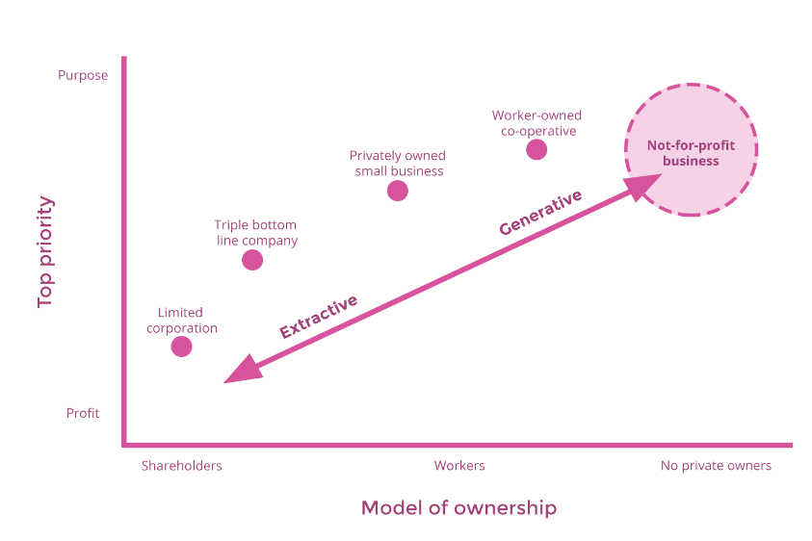
Plural and democratic ownership of economy
Notes:
Ownership is key here…
To challenge the current economic model, we must populate our places with businesses that share their profits and surplus more fairly with workers, owners and communities.
In practice this means social enterprises, cooperatives and worker owned business as well as private business that is committed to a triple bottom line (concern for workers rights and the environment as well as profit).
This requires economic development practice to be directed towards growing and supporting more of these businesses.
Again, local governments will take the lead here, but we are increasingly seeing other anchor institutions taking steps to develop their role in this approach.
OLD NOTES – weave second para into above
The UK is the fifth most unequal country in the world, according to the OECD. Financial wealth is held by a small minority, 44% of the UK’s wealth owned by just 10% of the population. At a local level, this means that the wealth generated by workers, local people, communities, local enterprise and business in our towns and cities does not flow back to them, but instead is extracted by distant shareholders as profits and dividends.
At the heart of community wealth building is the principle that wealth is broadly held. Cooperatives, mutually owned businesses, SMEs, municipally owned companies and socially minded companies enable the wealth generated in a community to stay in that locality and play a vital role in counteracting the extraction of wealth as they are more likely to employ, buy and invest locally. Anchors therefore have a key role to play in encouraging a diverse range of ownership models in their supply chains.

Slide 16
Progressive procurement
Context
Cost is often the dominant determining factor in who gets contracts.
Many anchor institutions spend large percentages outside their local area, and with businesses which are not socially generative.
Solution
Anchor institutions can use their procurement processes to create dense local supply chains and support businesses which are more likely to employ locally and recirculate wealth.
Notes:
Closely linked to the ownership pillars is the spending or procurement pillar,
Large anchors spend potentially billons of pounds in the local economy – can more of this be directed towards more locally productive forms of business – enabling more wealth and resource to be kept within the confines of the local economy?
By adapting their procurement processes and decision making, anchor institutions can create dense local supply chains and ecosystems of local enterprises, SMEs, employee owned businesses, social enterprises, cooperatives and other forms of community ownership.
This is important because these types of businesses are more likely to support local employment and have a greater tendency to recirculate wealth and surplus locally, helping to reduce carbon footprint.
Preston’s efforts to localise the impact of collective spending amongst the city’s anchor institutions has brought millions of pounds back into the local economy. The recirculation of over £200m being spent with local suppliers as a result of the changes in procurement behaviour across anchor institutions has had a positive multiplier effect on local jobs, health and wellbeing.
This has increased local economic expenditure, raised average wages and, crucially, it has correlated with improvements in socioeconomic deprivation since the programme has started. Furthermore, a new National Institute for Health and Care Research (NIHR) project has also illuminated further positive evidence. In short, during the period since these interventions have been introduced, there have been fewer mental health problems than would have been expected compared to other similar areas. As a recent paper concludes, these interventions potentially provide an effective model for economic development that leads to substantial health benefits.

Slide 17
Socially productive use of land & property
Context
Ownership of land is concentrated in the hands of the few
The least wealthy 30% have no net property wealth at all
Solution
Assets are owned and managed in ways which ensure that they generate wealth for local citizens
Community Land Trusts and Public-Common Partnerships
Notes:
In terms of the land and property pillar – anchors often have surplus land – can this be used to support local generative business activity or can it be used to support the building affordable housing?
How land and property assets are owned and managed are key features of any local economy. Land ownership matters because it is an expression of economic and political power, and in the UK the ownership of land is concentrated in the hands of the very few while the least wealthy 30% have no net property wealth at all.
The solution of a CWB approach would be that assets were owned and managed in ways which ensure that they generate wealth for local citizens, for example public land owners can transfer under-utilised assets to Community Land Trusts, or through Public-Commons Partnerships.
Community Land Trusts (CLTs) are democratically run organisations set up to develop and manage land and assets in the interests of their members. They tend to be set up to solve a local problem, such as unaffordable housing, or derelict and unproductive land. CLTs are driven by concerned members of communities who wish to take economic development into their own hands. Whilst they tend to be vehicles for the long-term stewarding of affordable housing, they can also develop other assets important to the community, such as community-run pubs, food growing or workspaces. Currently, there are 263 legally incorporated CLTs in England and Wales. Oxford is the least affordable city in the UK. To combat this, Oxford CLT are currently developing six affordable, co-operative and environmentally sustainable homes for rent. Oxford CLT have also set their sights on two more locations in the city: the Irving Building, where they hope to redevelop a former school into 26 zero carbon affordable homes; and Wolvercote Paper Mill, an ambitious bid to buy land from The University of Oxford for a 260-home eco-village.

Slide 18
Making financial power work for local places
Context
The UK banking sector is orientated to global markets rather than local investment
Access to credit is the life blood of many small businesses but there has been a stagnation of lending
Solution
Measures that channel investment to local communities while still delivering a steady financial return for investors, including:
Local pension funds, credit unions, mutuals and community banks
Notes:
Next is Finance – can local sources of finance be used to support local more socially productive forms of business or can things like anchor pension fund be used to invest in local priorities again such as affordable housing – not fossil fuel industries!
Rather than attempting to attract national or international capital, community wealth building seeks to increase flows of investment within local economies, by harnessing the wealth that exists locally. Measures that channel investment to local communities while still delivering a steady financial return for investors, including: Local pension funds, credit unions, mutuals and community banks. So to give you an example of some of these:
Local authority pension funds held £275bn in assets across England and Wales in 2018 and make substantial investments across the UK. Community wealth building seeks to channel this wealth to local communities while still delivering a steady financial return for portfolio holders. It is important to consider not just the geography of where the investments are going, but the nature of the business invested in. Channelling investment to the more socially generative side of the economy has multiplier effects upon social, economic and environmental value. ­
Credit unions offer an alternative to traditional banks and building societies for personal saving and borrowing.
They can be a lifeline for individuals unable to access ordinary banking products. As non-profit entities, there are no third-party shareholders extracting profit, money is simply reinvested for the mutual benefit of the members. Traditionally, members would be from the same town, industry or trade union, although their reach has now expanded online. In 2018, credit unions across the UK had over 2 million members and held £3.3bn in total assets. London Plus Credit Union works in partnership with Hexagon Housing Association to give tenants access to financial services such as low-cost loans to tackle predatory payday lending, safe savings to avoid unexpected debts and money management advice. The credit union serves residents and workers from a selection of London boroughs, housing association tenants, as well as members of specific churches and Unite the Union.
LEAVE
A group of innovators, led by RSA Fellow James Moore, and a team with over 150 years banking experience between them have set up the Community Savings Bank Association (CSBA) to facilitate the development of a network of independent, customer owned, local banks across the UK.
Work led by the Royal Society of Arts, Manufactures and Commerce (RSA) is promoting this regionally focused, mission-led model of community banks to advance the banking sector and put sustainable development, people and planet, back at the heart of the UK investment sector.
The first of the Community Savings Bank Association will be Avon Mutual, which will take local savings and use them to create local loans. Avon Mutual aims to serve the everyday financial needs of ordinary citizens, local community groups, and small and medium sized companies. It will also work closely with community development corporations, community development finance institutions, local social investment funds, revolving loan funds and others. It aims to become a key anchor institution focused on shifting the region’s economy to promote sustainable and equitable prosperity.

Slide 19
Fair employment and just labour markets
Context
The rise of in-work poverty and zero hour contracts
Wages in the UK falling whilst inflation increases during a cost-of-living crisis
Solution
Anchor institutions have a defining effect on the prospects of local people. Recruitment from lower income areas, paying the Living Wage and building progression routes all improve local economies.
Notes:
Finally, in terms of the workforce or employment pillar - Anchor institutions employ thousands of people. Fair pay, good terms and conditions and ensuring that job vacancies and progression routes are directed towards people and communities who need them most has a tangible impact on local people, helping to address poverty deprivation and inequality.
The rise of in-work poverty and zero hour contracts coupled with the erosion of job security mean that the reality of employment for many in the UK is increasingly precarious, especially as inflation continues to rise whilst wages fall. Anchors can play a role in supporting local people access employment and develop their skills through the establishment of employment and training initiatives. Such initiatives can transform the life chances of local residents in some of the most disadvantaged areas of the UK by providing opportunities and support for jobseekers, providing pre-recruitment training and job matching to local employers.
Leeds Teaching Hospitals NHS Trust
The Trust’s pre-employment training scheme offers a mixture of work experience and knowledge building around basic Maths and English. The programme runs for a total of six weeks. The first two weeks are spent training at Leeds City College, then the following four weeks are spent on a work placement within the Trust, with ongoing support and training (four days in work, one day in Leeds City College). The programme has a particular focus on building the confidence of the long-term unemployed.
The Trust also has a focus on promoting careers to young people in the local area, and has established a number of health career ambassadors and have a cohort of staff who go into schools in areas of high deprivation.

Slide 20
Questions?

Slide 21

Community wealth building in practice
CHALLENGE
Developing and growing local enterprise
CWB SOLUTION – Bringing procurement into economic development
A result of Covid and the need to administer business support grants, many councils now have increased intelligence about the nature of their local SMEs
In Fife, Luton and Carmarthenshire, they are using this intelligence to target their own procurement expenditure towards growing and diversifying their local SME base
These councils are using this to socialize these businesses
Progressive procurement
Notes:
Looking for opportunities to support and influence the behaviour of local SMEs is emerging as a key local economic development tactic to promote a more inclusive local economy.
As a result of Covid and the need to administer business support grants, many councils now have increased intelligence about the nature of their local SMEs. In councils such as Fife, Luton and Carmarthenshire, they are using this intelligence to target their own procurement expenditure towards growing and diversifying their local SME base. Here, economic development officers are engaging with local SMEs to make them aware of their goods and services pipeline, with a view to more of their supply chains being delivered by these local businesses. Through this engagement these local authorities are using this as an opportunity to address the environmental crisis – supporting local SMEs with retrofit and access to environmental grants. They are also encouraging the adoption of the living wage, as well as initiating discussions around succession planning, to potentially transition to worker ownership. This enables these local businesses to grow and develop with greater social and environmental purpose.
Local Government Association (2021). Supporting councils with business engagement. Link.

Slide 22
Community wealth building in practice
CHALLENGE
Disconnected adult social care providers and low pay for staff
CWB SOLUTION – Newham Social Licensing in Homecare
The homecare sector is the most fragmented element of adult social care services with over 10,000 different providers.
Newham have moved to a patch-based service broken down into 8 community neighbourhood areas
They have lotted their contracts and specified that providers can deliver only one lot each
Providers must have good community knowledge, be local, reflect Newham’s diverse population and pay the London Living Wage
Fair employment & just labour markets
Notes:
This example is from Newham, where they’ve introduced social licensing in Homecare to tackle their fragmented care services and poor pay for people employed in the sector.
Part of this approach has been a move to a patch-based service that is broken down into eight community neighbourhood areas. They have then lotted their contracts and specified that providers can deliver only one lot each.
The Council have also specified that providers must have a good knowledge of the community’s geography, facilities and services and must operate from an office in Newham. They are required to actively recruit care workers who reflect the Borough’s diverse population, specifically in relation to gender, culture, ethnicity and spoken language. They are also required to pay their workforce the London Living Wage and to adhere to the principles of the UNISON ethical care charter.
In practice, this creates a strong disincentive for larger more extractive providers to enter the market. As a result, Newham now have locally-based small SMEs delivering their homecare service, who are required to operate there with a concern for the wider community and workers, alongside the pursuit of profit.

Slide 23
Community wealth building in practice
CHALLENGE
High levels of unemployment, low skills and anchors with high vacancies
CWB SOLUTION - iCan
An employment solution set up through covid to help recently redundant hospitality workers move into an NHS job
Now expanded to match unemployed Birmingham residents with entry-level roles
A piece of community wealth building infrastructure
Fair employment & just labour markets

Slide 24

Community wealth building in practice
CHALLENGE
Climate crisis and rising energy costs
CWB SOLUTION – Oldham Energy Futures
A programme with two low-income communities in Oldham which puts residents at the heart of decision making and aims to transform the ownership of energy in the borough
Involves three pilot projects:
  Upgrade local buildings and create low carbon homes
  Develop an EV and e-bikes local mobility project
  Install new renewable energy generation for the borough
Plural ownership of the economy
Notes:
Beginning in spring 2021, the Oldham Energy Futures team worked with communities in a participative process which has enabled residents to, not only have their say in how they want the energy transition to happen in their place, but also to gain the skills and knowledge needed to take advantage of new opportunities in the low carbon sector.
This work was enabled by Oldham Council’s pre-existing commitment to community wealth building, and a local green new deal which includes a focus on community-led and -owned solutions to the energy transition (e.g Oldham Community Power).
Two low-income neighbourhoods, Westwood and Sholver, were selected for pilots on the basis that they would benefit from improved local provision, the residents were often marginalised in decision making, and they had an existing strong community organising base.
As well as local residents, the project engaged with key local stakeholders (such as First Choice Homes, a local housing association) to boost the project’s impact.
Ultimately the project produced community-owned action plans, and led to the development of a toolkit (available on our website) to allow other places to replicate the approach.

Slide 25
Community wealth building in practice
CHALLENGE
NHS organisations with large budgets, health inequalities growing
CWB SOLUTION – Health institutions as key anchors
Health spending has the potential to be a core economic driver in local economies
Hywel Dda University Health Board (HDUHB) are exploring how a progressive health board can maximise the impact of its spending power for wellbeing in Wales
HDUHB is developing a whole local health board approach to spending, collaborating with other anchors on areas such as food procurement
Progressive procurement

Slide 26
Community wealth building in practice
CHALLENGE
Supply teachers on low-pay, zero-hour contracts, and schools paying over the odds to agencies
CWB SOLUTION – North of Tyne Supply Teacher Cooperative
88% of supply teachers work in private supply chain agencies
Falling pay, eroding of job security and pension rights
Group of supply teachers in the North-East working together with the Combined Authority and local trade unions to create a supply teacher co-operative
Fair employment & just labour markets
Notes:
88% of supply teachers reported that private supply agencies were the only way they could obtain work, reflecting the fact that, over the last decade, agencies have replaced publicly run supply pools.
Commercial supply agencies retain up to 38% of the fees charged to schools, while the teachers themselves have faced falling pay, erosion of job security and pension rights and attacks on their employment rights. Schools are missing out too – with fees and charges rising significantly. This double-tapped extraction of wealth from the purses of both the public sector and workers is endemic in the UK.
Motivated by their own experiences, a group of supply teachers in the north east has been working closely with the National Education Union, National Association of Schoolmasters/Union of Women Teachers, TUC and North of Tyne Metro Mayor, Jamie Driscoll, since 2020, to create an alternative – a supply teacher co-operative. Owned and controlled by the teachers themselves, the co-operative will replace the prioritisation of profit with an imperative to pay fairly and provide good terms and conditions for teachers, ensure schools receive a high quality of service and to represent the interests of children.
EXTRA INFO IF QUIZZED
To develop the model, the teachers have drawn on support from CLES (we carried out an early feasibility study, funded by the North of Tyne Combined Authority), business development funding from Co-ops UK’s Hive programme and a co-operative specialist at the North East Business Innovation Centre. They will soon be in a position to register the co-operative and begin the process of raising the finance necessary to launch later this year.
While it is testament to the commitment of the group that they have got this far, it is also clear that this model is rooted in collaboration. The teaching unions, schools, the North of Tyne Combined Authority and specialist business support services have come together to create a new alternative to the extractive model of commercial employment agencies.

Slide 27
Community wealth building in practice
CHALLENGE
Lack of investment in local places
CWB SOLUTION – Investing local pension funds in the local area
Preston City Council have partnered with Lancashire County Council to maximise the social return of public pensions through the Lancashire Local Government Pension Fund. Since 2013, the Pension Fund has allocated £100m for investment in Preston and South Ribble and a further £100m for investment in wider Lancashire.
The Council are now drawing up plans to establish a Lancashire community bank in partnership with Liverpool and Wirral Councils. A bank of this type would support local SMEs and the reduction of financial and social inequality would be at the heart of its mission.
Making financial power work for places

Slide 28
Questions?

Slide 29
Break
5 mins

Slide 30
Discussion
Which of these examples resonated with you?
How would these examples translate to your place/organisation?
20 mins

Slide 31
What next?
What will you do on Monday?
10 mins

Slide 32
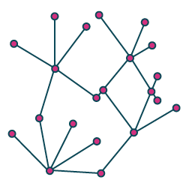
Get in touch
0161 236 7036
laurenbond@cles.org.uk
victoriabettany@cles.org.uk
@CLESthinkdo
www.cles.org.uk

